Slide 1
Communication Gap

Slide 2

Web Design Communication Gap
Accessibility
CMS (Content Management System)
CSS (Cascading Style Sheet)
Flat Design
FTP (File Transfer Protocol)
Functionality

Slide 3
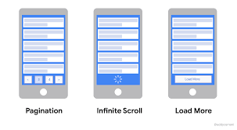
Hosting/Domain name
HTML (HyperText Markup Language)
Infinite Scrolling
Javascript
Mockup

Slide 4
Negative Space
Plug-in
Responsive
SEO (Search Engine Optimization)
Social Media
Static/Dynamic

